Slide 1

MESS MANAGEMENT SYSTEM
Submitted By:
Khushi Verma (2023CA52)
Kushagra Kumar (2023CA56)
Om Prakash (2023CA68)
Utkarsh Awasthi (2023CA108)
Under the guidance of
Dr. Abhimanyu Sahu
(CSED)

Slide 2
Introduction:
EATSPEAK is a software project designed to make mess-related communication easier for college students, especially in institutes like MNNIT ALLAHABAD. It's built to help address day-to-day issues with mess food and services.
It gives students a voice to raise concerns about poor food quality, hygiene, or any mess-related problems they face.
Students can also share feedback and keep a check on their food-related expenses through the platform.
For mess administrators, it provides a way to quickly identify and solve issues reported by students.
It also allows admins to regularly update the mess bills and menu, ensuring transparency and better planning.

Slide 3

Motivation behind the topic:
Clear and Transparent Mess Expenses: Both students and mess admins will have a clear understanding of where the money is being spent.
Daily Food Feedback: Students can share their daily food experiences, and admins can use this input to improve future menus.
Always Updated Menu: Students can easily check the most recent mess menu anytime.
Easy Payments: Students can pay their mess bills quickly and conveniently through integrated payment options.

Slide 4

Proposed Solution :
Accessible Anytime, Anywhere: The web app is always available, so students can use it whenever they need.
Seamless Feedback: Students can share their feedback on meals from anywhere, at any time.
Easy Complaints with Proof: Students can quickly raise concerns about the mess and even attach screenshots for better clarity.
Daily Expense Records Online: Every day's bill is stored online, making it easy to review past expenses.
Real-Time Expense Tracking: Students can see how much of their mess fee is remaining and track their spending effectively.
Visual Insights from Feedback: Feedback is turned into graphs so admins can easily see which meals need improvement.
Always-Updated Menu: The latest mess menu is made available to all students once the admin uploads it.
Flexible Mess Fee Payment: Students can pay their mess bills anytime using a variety of secure payment methods.

Slide 5






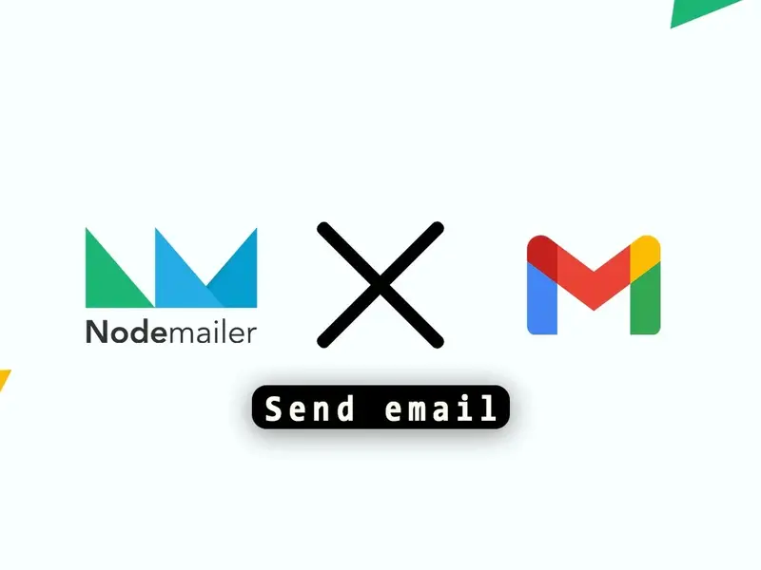
Tech Stack :

Slide 6
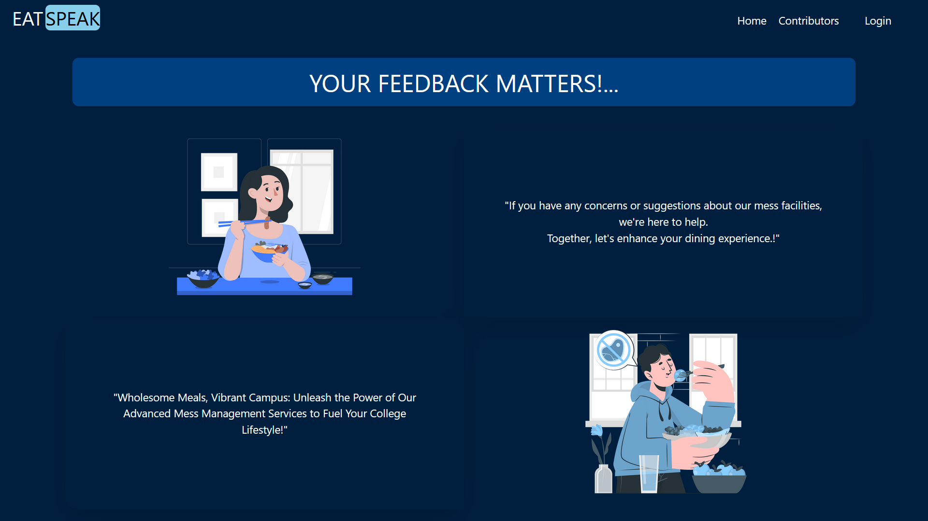
Home Page :

Slide 7
Contributors:

Slide 8
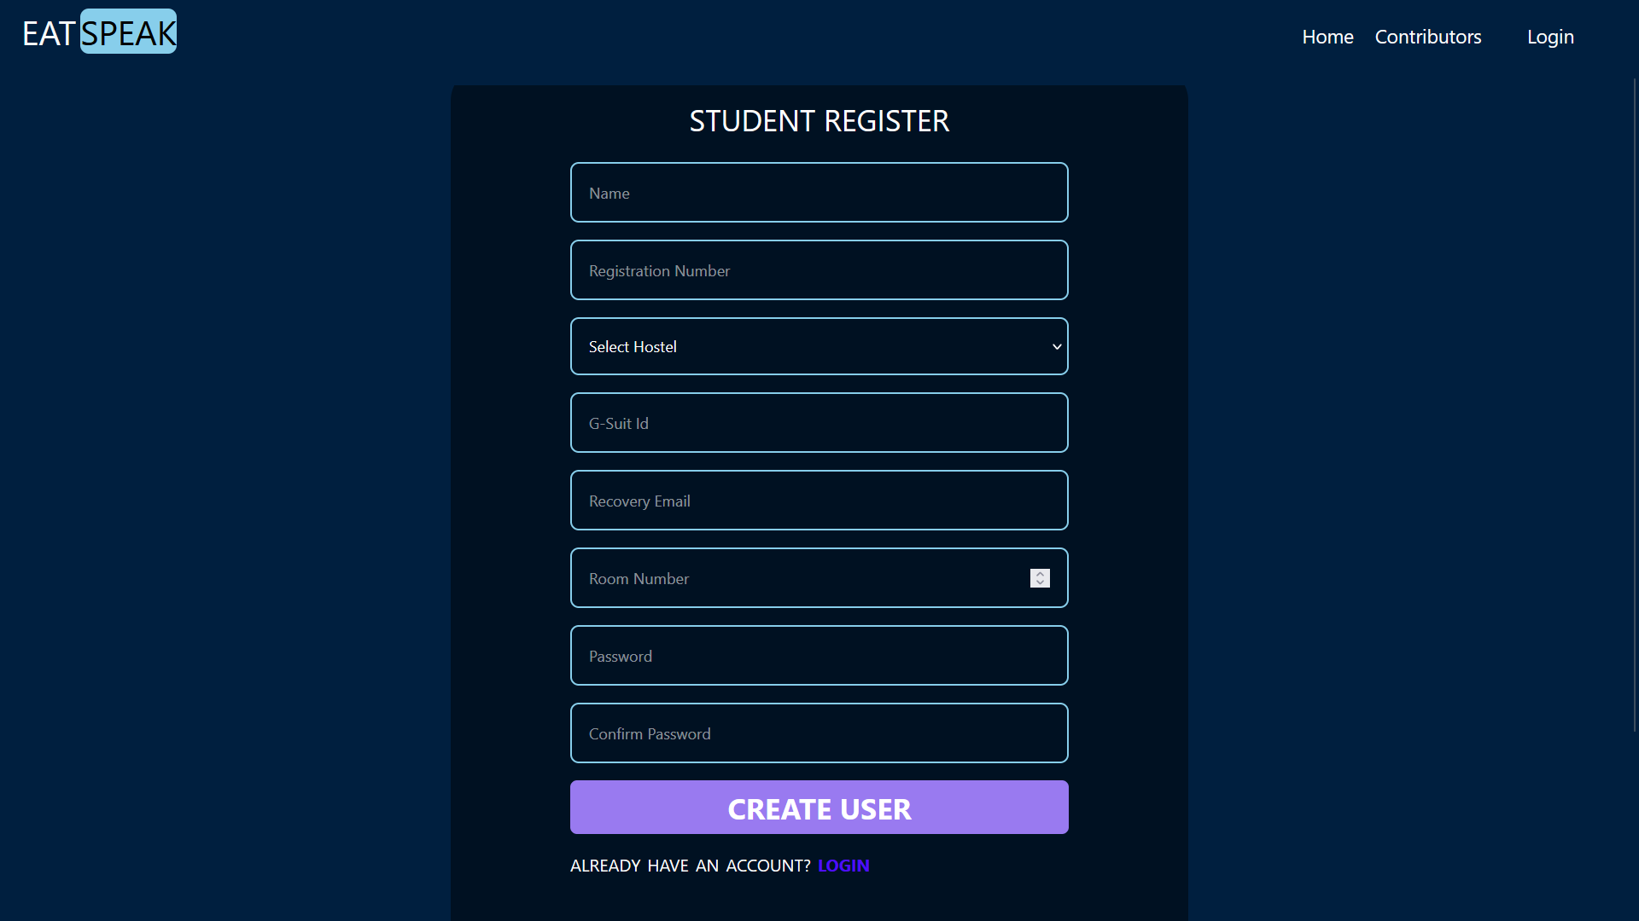
Register student :
This is a powerful tool in public speaking. It involves varying pitch, tone, and volume to convey emotion, emphasize points, and maintain interest:
Pitch variation
Tone inflection
Volume control

Slide 9
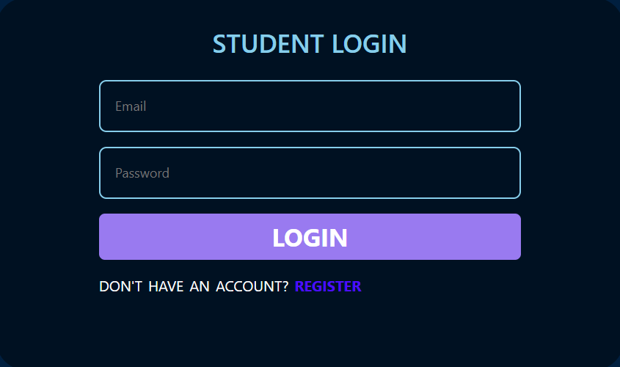
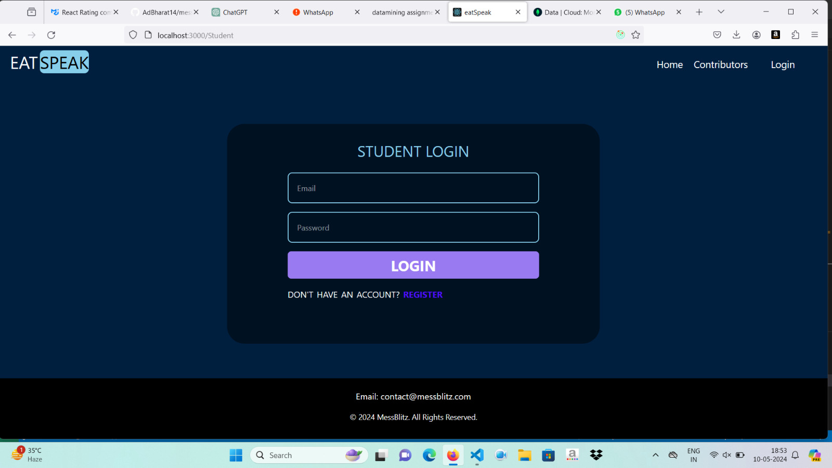
Login :

Slide 10
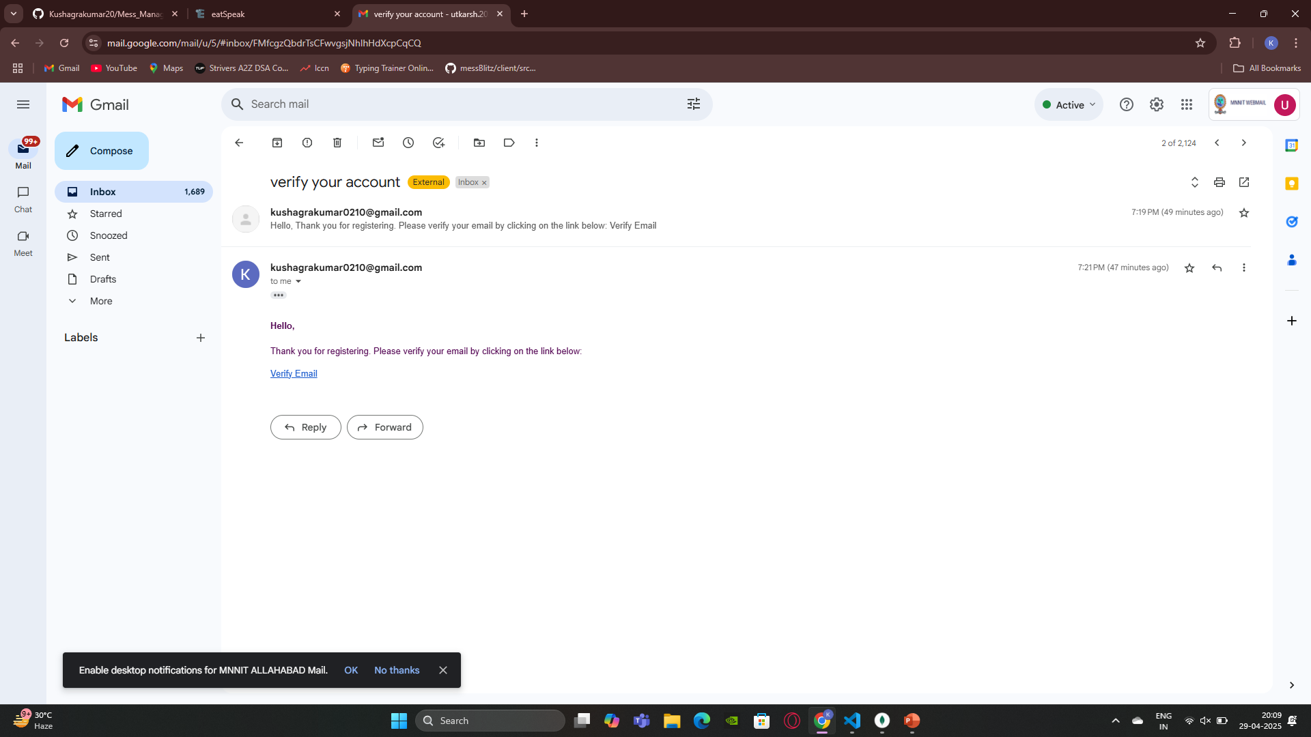
Verification :

Slide 11
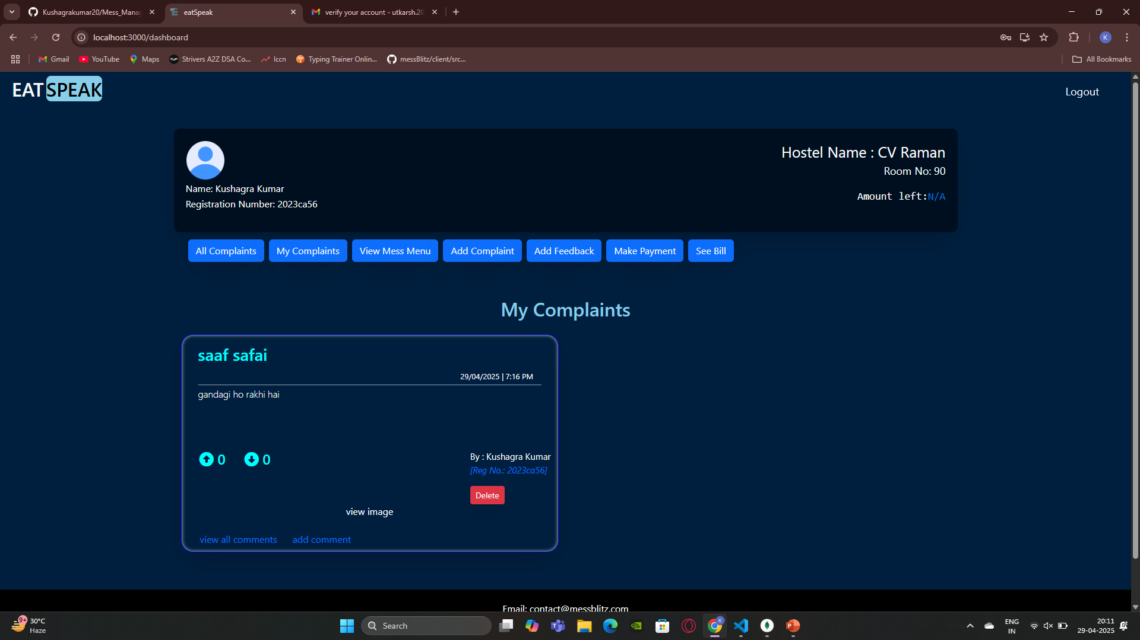
Student dashboard:

Slide 12
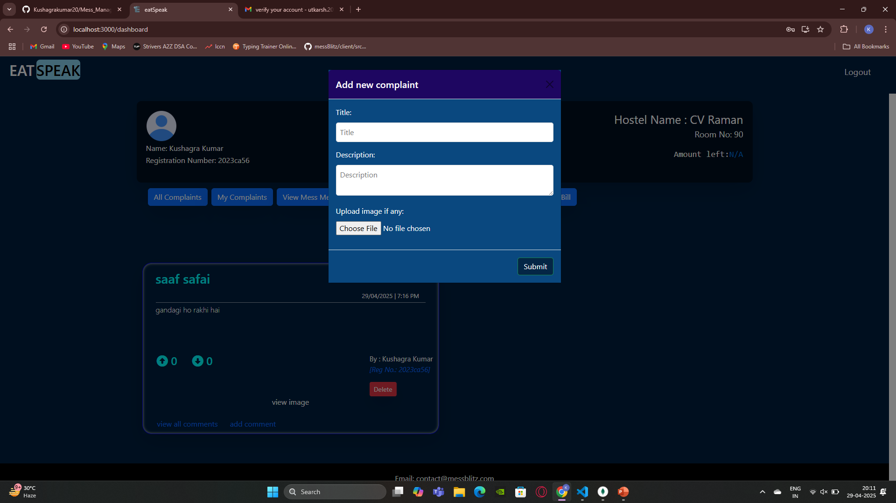
Add complaint:

Slide 13
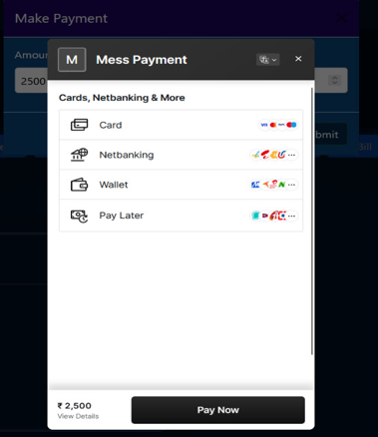

Payment checkout:

Slide 14
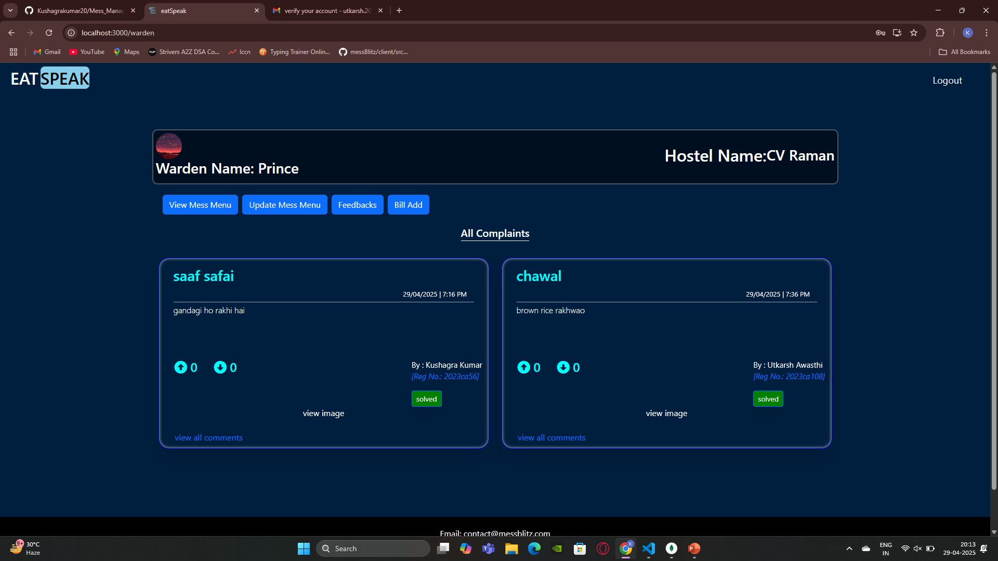
Warden dashboard:

Slide 15
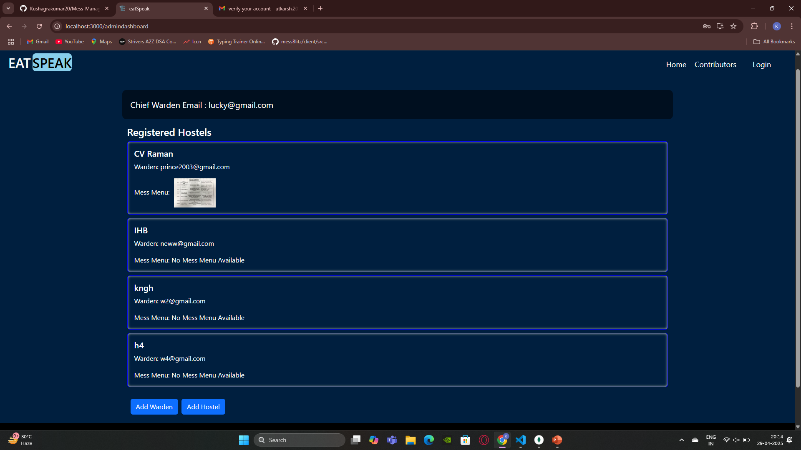
Chief Dashboard:

Slide 16
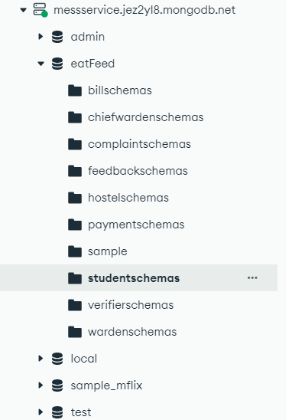
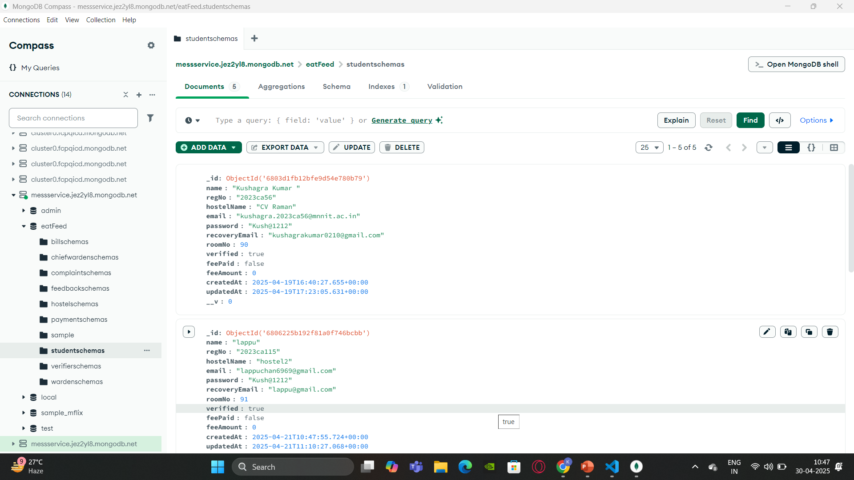
Database :

Slide 17
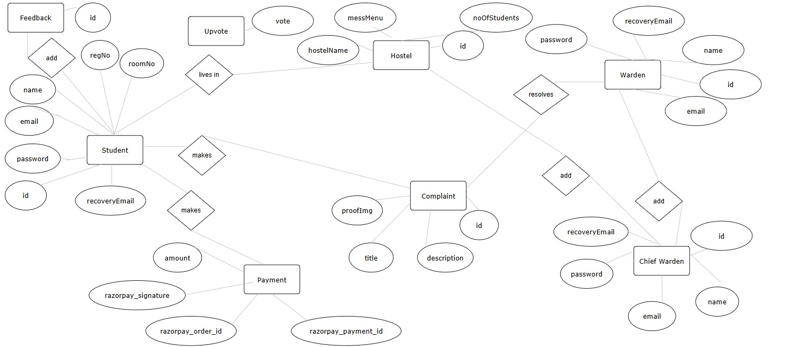
ER Diagram:

Slide 18
Limitations :
Dependency on Student Engagement The system relies heavily on students' active participation for various tasks such as lodging complaints, giving feedback, making payments, and overall engagement. If students are not consistent, the system’s efficiency suffers.
Administrative Workload Administrators face a significant workload managing a wide range of responsibilities, including complaint resolution, billing, updating menus, analyzing data, and maintaining the system.
Incomplete Digital Transformation Despite some digital features, the system still involves paperwork. This prevents a full transition to a paperless environment and can cause issues in data management and accessibility.

Slide 19
Conclusion :
Purpose
To help students and administration track the exact expenditure and monitor the quality of the food served in the mess.
Benefits
Improved quality and taste of the food.
Students can conveniently make payments for the mess fee.
Ensures transparency in all mess-related expenditures.
Technologies Used
Frontend: React.js
Backend: Node.js, Express.js
Database: MongoDB

Slide 20
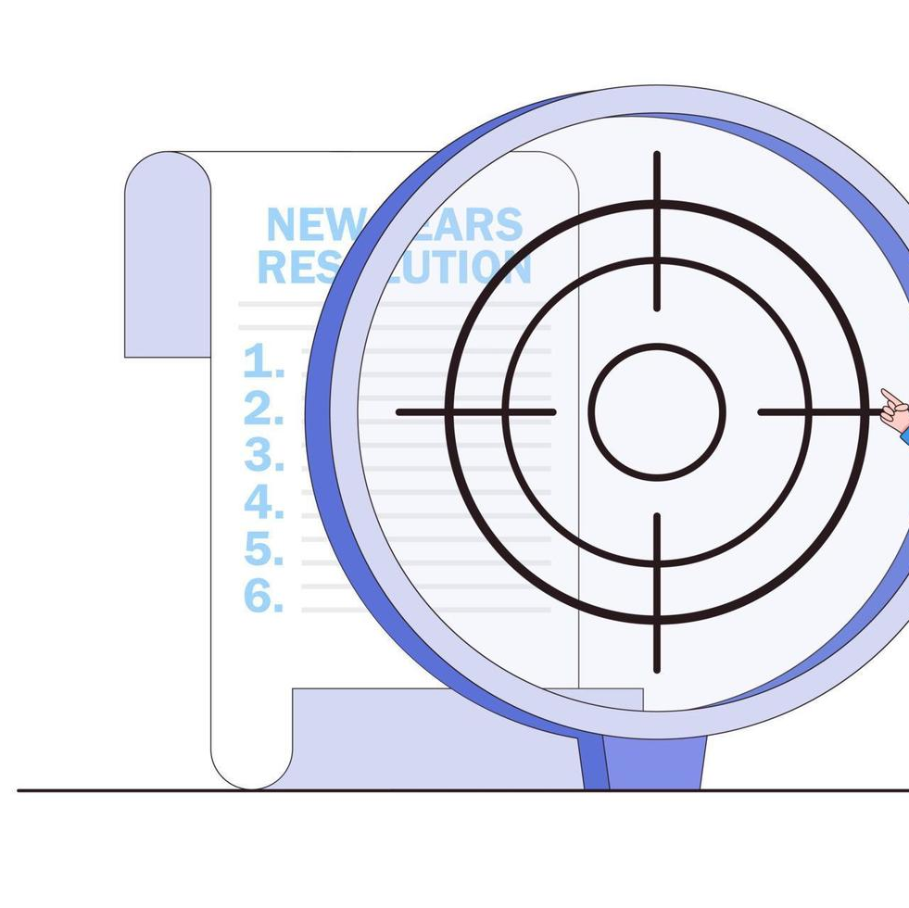
Future Scope :
Expense Tracking System Let's build a smart system to track all mess-related expenses like staff salaries and raw material costs. By categorizing these expenses, managing and auditing them becomes much easier and more efficient.
Mobile App for Mess Services A mobile app can make student life smoother by allowing them to submit complaints, make payments, track their mess expenses, and give feedback — all from the comfort of their phones, anytime and anywhere.
QR Code Entry for Mess Say goodbye to long lines! Students can simply scan a QR code to enter the mess, making the process faster, smoother, and more secure.
Hostel Money Transfers via App Transferring money between hostel accounts can be made hassle-free through digital tools. This is especially useful when expenses are shared or reimbursed, ensuring everything is clearly tracked and transparent.
Role-Based Work Distribution To reduce the burden on administrators, we can introduce specific roles like an accountant, mess head, and student mess secretary. Dividing responsibilities this way helps everything run more smoothly and ensures better management.

Slide 21
Thank You!!

